Slide 1
My ELI related scientific activity
2015 - 2016
Imre Ferenc Barna
2016.April 5.

Slide 2
Outline
Published works 2015 -2016
Laser assisted proton collision on nucleus for mono and bichromatic fields
Electron accelaration in underdense plasmas mono and bichromatic fields
Plans for 2016
Electron accelaration in underdense plasmas, beyond paraxial approx.
Single photoionization of Rb atom
Morse potential
Self-similar analysis of non-linear electrodynamics

Slide 3
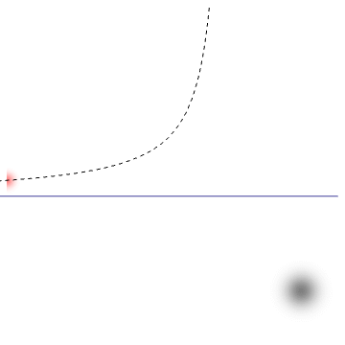
Published works 2015 -2016
we consider a nulcear scattering process
in a simultaneous laser field
I.F. Barna and S. Varró "Laser assisted proton collision on light nuclei at moderate energies" Laser and Particle Beams 33, (2015) 299.
I.F. Barna and S. Varró "Proton scattering on carbon nuclei in bichromatic laser field at moderate energies" Nucl. Instr. Meth. in Phys. Res. B. 369, (2016) 77

Slide 4
Theory of laser assisted collision
non-relativistic theory
Volkov wavefunction for the projectile, analytic solution for charged particle in laser field
.
dipole approx, now we use linear polarization
First Born approx. for the scattering process BUT includes all order of photon absorption and emission in a non-perturbative way
Fourier transformed, Dirac delta for Bessel function contains,
scattering potential energy conservation physics from laser
phys. from interaction

Slide 5
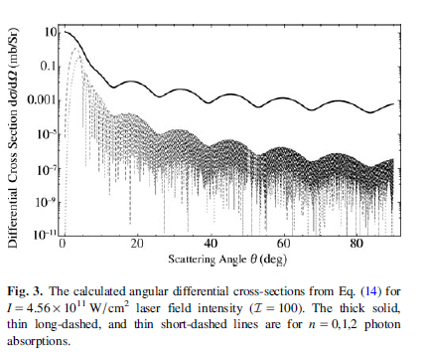
Theory of laser assisted collision
Results

Slide 6
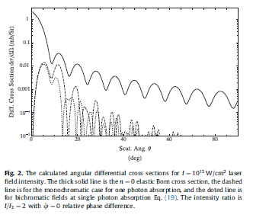
Theory of laser assisted collision
results for bichromatic fields
The cross section formula
is modified

Slide 7
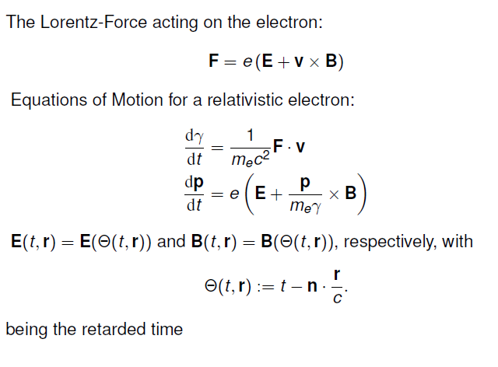
The laser accelaration in underdense plasmas
The laser accelaration in underdense plasmas, go beyond the parallaxial approximation, together with Pocsai Mihály and Varró Sándor

Slide 8
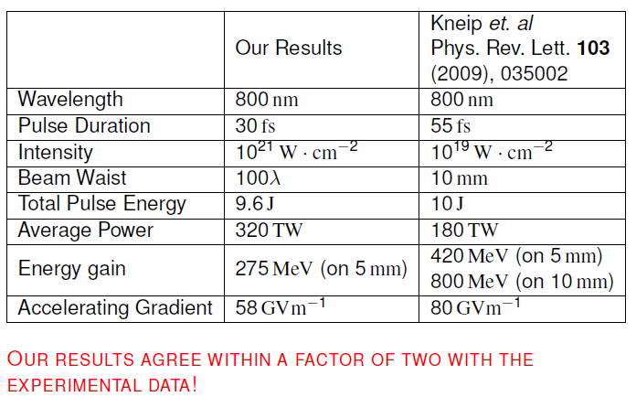
The laser accelaration in underdense plasmas
M.A. Pocsai, S. Varró and I.F. Barna "Electron acceleration in underdense plasmas described with a classical effective theory" Laser and Particle Beams 33, (2015) 307.

Slide 9
The laser accelaration in underdense plasmas
M.A Pocsai, S. Varró and I.F. Barna "Electron acceleration by a bichromatic chirped laser pulse in underdense plasmas" Nucl. Instr. Meth. in Phys. Res. B. 369, (2016) 50

Slide 10
Plans for 2016
The laser accelaration in underdense plasmas, go beyond the parallaxial approximation, together with Pocsai Mihály and Varró Sándor
Maybe Phd Sudent(s) of Dr. István Földes ☺

Slide 11
Plans for 2016
Morse potential in laser field,
together with Attila, Szabolcs and Sándor

Slide 12
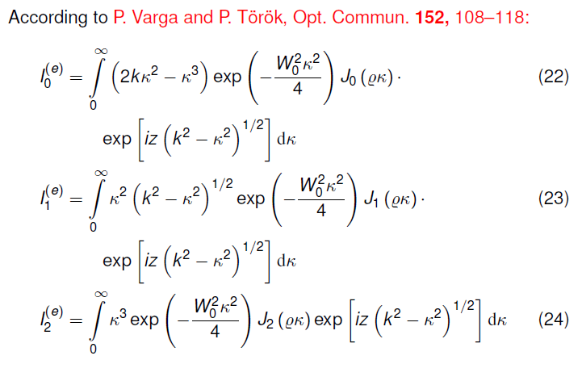
Plans for 2016

Slide 13
Plans for 2016

Slide 14
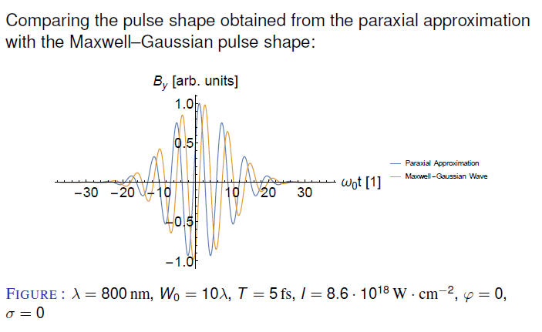
Plans for 2016

Slide 15
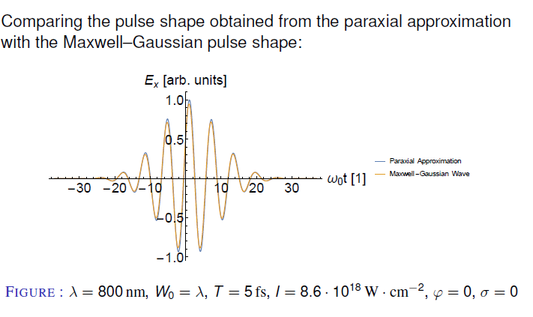
Plans for 2016

Slide 16
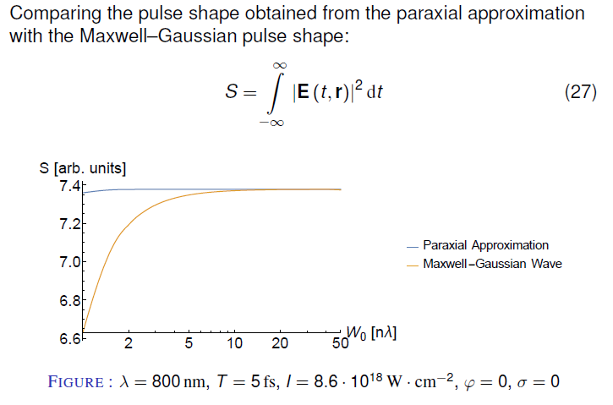
Plans for 2016

Slide 17
Plans for 2016

Slide 18
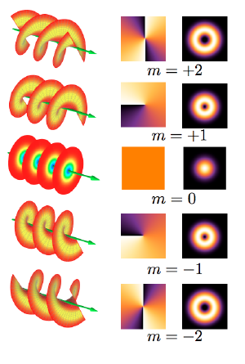
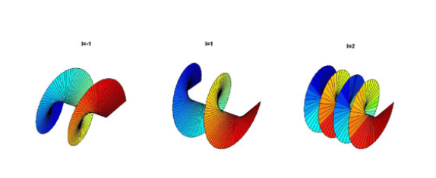
Plans for 2016
Different to circulary polarised light,
but not clear (at least for us) how

Slide 19
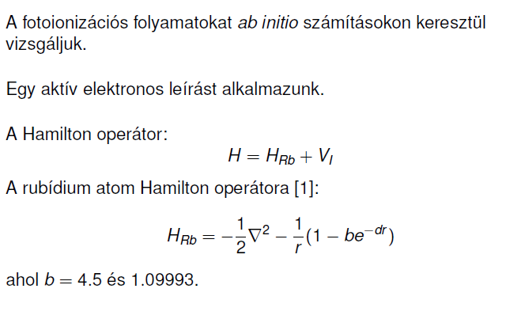
Plans for 2016
Photoionization of Rb atom
Pocsai Misi Phd-je

Slide 20
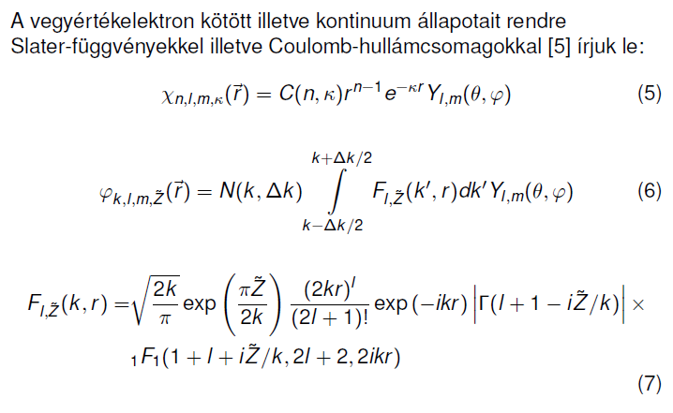
Plans for 2016
Photoionization of Rb atom

Slide 21
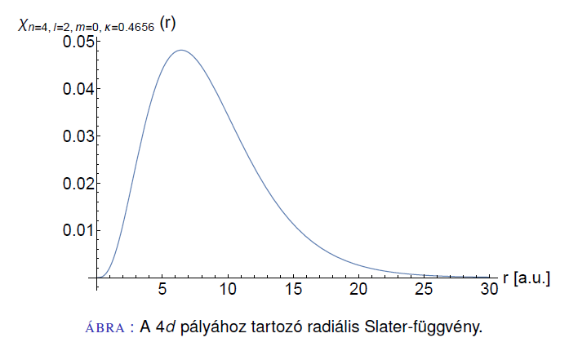
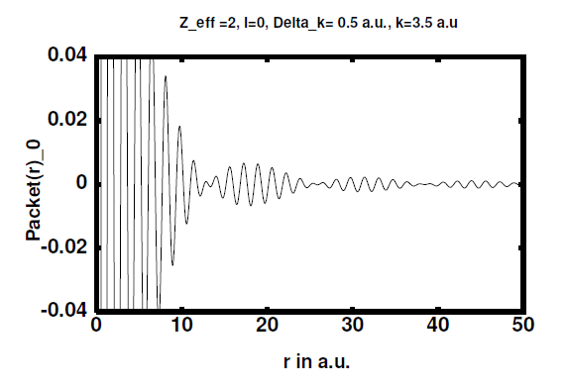
Plans for 2016
Slater hullámfüggvény
Reguláris Coulomb hullámcsomag

Slide 22
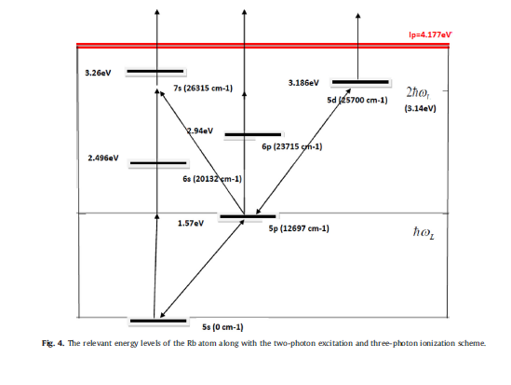
Plans for 2016
Miért jó ez?
Technikailag
szinte bármilyen
elektron kontinuum
diszkretizálható
E(eV)
0(eV)
k,dk
kötött állapotok száma
l=0,1,2,3,4
minden esetben
legalább még 10
Misi dolgozik rajta,
nyár elejére lesz
ionizációs számolás
ECAMP 12-re poszter

Slide 23
Plans for 2016
Just to finish the Morse for ECAMP12

Slide 24
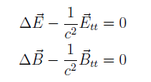
Plans for 2016
Self-similar analysis of non-linear electrodynamics
Together with M. Polner and P. Mati
- In 1934 Born-Infeld proposed non-linear ED to
remove point-like-particles induced singularities
in field theories
- above the Schwinger limit 10²⁹ W/cm² intensities
the dielctric response of vacuum itself becomes
non-linear (very long range ELI interest ☺)
- Lagrange density for linear versus non-lin ED
after variation we get the
equation of motion for the fields

Slide 25
Plans for 2016
Coupled 3D wave equation system
The 1D system
Self-similar Ansatz
Obtained ODE

Slide 26
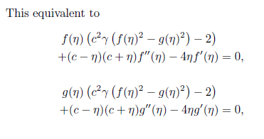
Plans for 2016

Slide 27
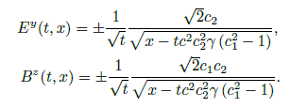
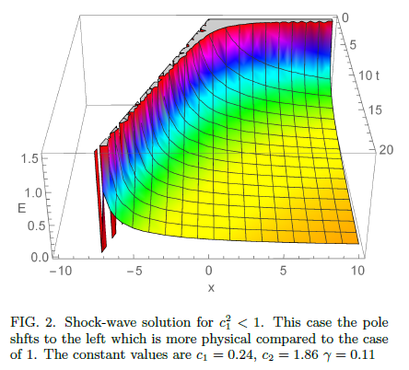
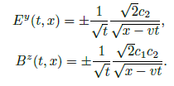
Plans for 2016
work is in progress

Slide 28
THANK YOU FOR YOUR ATTENTION!

